Slide 1
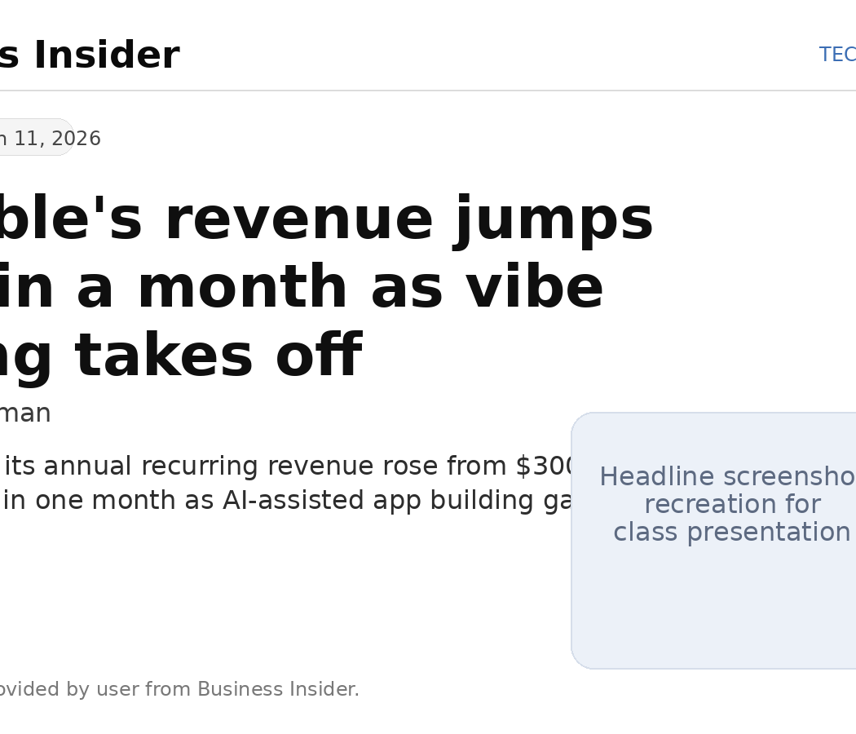
AI on Society • Weekly Digest Presentation
Lovable and the rise of vibe coding
Article: Lovable's revenue jumps 33% in a month as vibe coding takes off
Publication date: March 11, 2026
Article #: 2026-3
Source link
1
Notes:
[Sources] - Business Insider article: Lovable's revenue jumps 33% in a month as vibe coding takes off, Ben Bergman, published March 11, 2026, https://www.businessinsider.com/lovables-hit-400-million-arr-doubling-in-a-few-months-2026-3 - User-provided pasted article text in chat, used for the summary and headline details. [/Sources]

Slide 2
AI-generated summary: main findings and arguments
Submitted exactly as generated for class use
This article argues that vibe coding—using AI tools to let non-engineers generate software from prompts—is moving from experimentation into a fast-growing business category. The main evidence is Lovable’s jump from $300 million to $400 million in annual recurring revenue in one month, along with 200,000 new projects being created daily and plans to grow from 146 to about 350 employees. The article also argues that the market is expanding rather than becoming winner-take-all, because Lovable says many users pair its product with Anthropic’s Claude Code instead of choosing only one tool.
33%
$400M
200K
one-month ARR growth
annual recurring revenue
new projects created daily
Key takeaway
The article frames vibe coding as a fast-scaling category where AI tools are broadening who can build software, not just making existing engineers faster.
2
Notes:
[Sources] - Business Insider article: Lovable's revenue jumps 33% in a month as vibe coding takes off, Ben Bergman, published March 11, 2026, https://www.businessinsider.com/lovables-hit-400-million-arr-doubling-in-a-few-months-2026-3 - User-provided pasted article text in chat, used for the summary and headline details. [/Sources]

Slide 3
AI-generated summary: broader implications for society
The broader implication for society is that AI is lowering the barrier to software creation and shifting who can participate in digital production. If nontechnical founders, entrepreneurs, and office workers can build applications with AI assistance, innovation could become more distributed across society instead of staying concentrated in traditional engineering teams. At the same time, the article suggests a changing labor market in which AI fluency, product thinking, and the ability to work with automated tools may become more valuable, while organizations restructure hiring around these new capabilities.
Barrier to entry falls
Nontechnical users can participate more directly in software creation.
Work roles shift
AI fluency, judgment, and workflow design become more valuable alongside technical skill.
Innovation spreads outward
Digital product creation may become less concentrated inside traditional engineering teams.
3
Notes:
[Sources] - Business Insider article: Lovable's revenue jumps 33% in a month as vibe coding takes off, Ben Bergman, published March 11, 2026, https://www.businessinsider.com/lovables-hit-400-million-arr-doubling-in-a-few-months-2026-3 - User-provided pasted article text in chat, used for the summary and headline details. [/Sources]

Slide 4
AI-generated summary: relevance to the construction industry
For the construction industry, the article matters because many construction firms rely on people with deep field knowledge but limited programming experience. Vibe-coding tools could help project managers, estimators, safety teams, and operations staff quickly create custom dashboards, reporting tools, site documentation workflows, and internal apps without waiting on outside software developers. However, construction companies would still need governance, testing, cybersecurity review, and human oversight before using AI-built tools for safety, scheduling, contracts, or compliance, because errors in those areas could create serious operational and legal risks.
Potential construction uses
Required safeguards
• Safety reporting tools
• Field documentation workflows
• Estimating and dashboard apps
• Internal forms for project controls
• Testing before deployment
• Cybersecurity and data review
• Human approval for safety/contract use
• Governance for compliance workflows
4
Notes:
[Sources] - Business Insider article: Lovable's revenue jumps 33% in a month as vibe coding takes off, Ben Bergman, published March 11, 2026, https://www.businessinsider.com/lovables-hit-400-million-arr-doubling-in-a-few-months-2026-3 - User-provided pasted article text in chat, used for the summary and headline details. [/Sources]

Slide 5
Interactive component: class discussion / quick response
1. Which construction task is the best fit for vibe coding first: safety reporting, field data capture, scheduling, or estimating?
2. What is the biggest risk of AI-built tools in construction: incorrect data, cybersecurity, compliance mistakes, or overreliance by staff?
3. Should non-programmers be encouraged to build internal tools if IT or management reviews them before use?
Date: March 11th 2026 ____________________
Article Lovable and the rise of vibe coding
___________________
Article link
5
Notes:
[Sources] - Business Insider article: Lovable's revenue jumps 33% in a month as vibe coding takes off, Ben Bergman, published March 11, 2026, https://www.businessinsider.com/lovables-hit-400-million-arr-doubling-in-a-few-months-2026-3 - User-provided pasted article text in chat, used for the summary and headline details. [/Sources] Interactive discussion prompts are original presentation framing based on the cited article.

